Slide 1
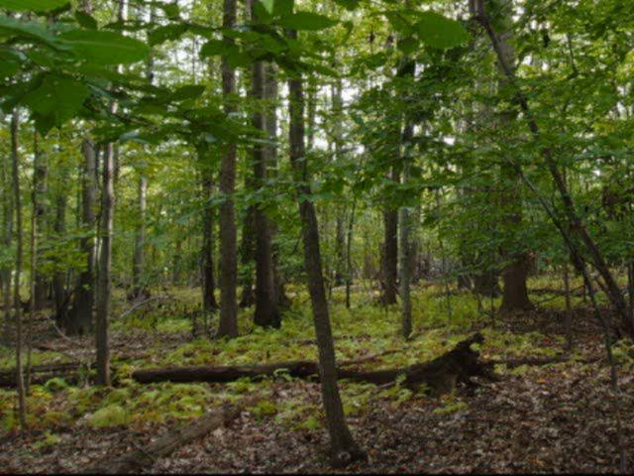
INTEGRATING CONSERVATION WITH DEVELOPMENT
GROUP 16 (TOPIC 18)

Slide 2
OUTLINE
EXEGESIS ON SUBJECT MATTER; CONSERVATION AND DEVELOPMENT
STRATEGIES IMPLICATED IN INTEGRATING CONSERVATION WITH DEVELOPMENT
THE BENEFITS OF INTEGRATING CONSERVATION WITH DEVELOPMENT
RELEVANT CASE STUDY ON SUBJECT MATTER
CONCLUSION
REFERENCES

Slide 3
DEFINITION OF TERMS
CONSERVATION
It is the protection, preservation and management of natural resources.
DEVELOPMENT
It is the process of improving human well-being through economic growth and social progress.

Slide 4
STRATEGIES IMPLICATED IN INTEGRATING CONSERVATION WITH DEVELOPMENT
STAKEHOLDER ENGAGEMENT:
Involve local communities, indigenous groups, and other stakeholders in decision-making processes.
Incorporate their knowledge and perspectives to ensure effective conservation and development strategies.
EDUCATION AND AWARENESS:
Raise awareness about the importance of conservation and sustainable development among the public.
Promote environmental education programs to build a culture of conservation.

Slide 5
STRATEGIES IMPLICATED IN INTEGRATING CONSERVATION WITH DEVELOPMENT CONT’D
POLICY AND GOVERNANCE:
Develop and enforce regulations that integrate conservation considerations into development projects.
Establish protected areas, wildlife sanctuaries, and sustainable development guidelines.
SUSTAINABLE LAND AND RESOURCE MANAGEMENT:
Implement responsible land-use planning to balance economic activities with environmental protection.
Promote sustainable farming practices, reforestation, and watershed management to conserve natural resources.

Slide 6
BENEFITS OF INTEGRATING CONSERVATION WITH DEVELOPMENT
ECONOMIC BENEFITS
ENVIRONMENTAL BENEFITS
SOCIAL BENEFITS

Slide 7
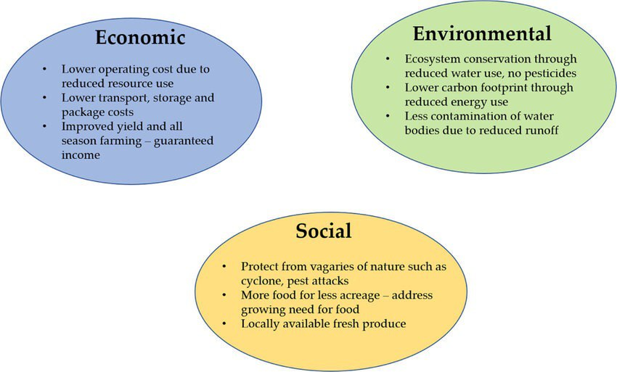
Fig.1: Benefits of integrating conservation with development

Slide 8
CASE STUDY: COSTA RICA'S PAYMENT FOR ECOSYSTEM SERVICES (PES) PROGRAM
Costa Rica implemented a PES program to reward landowners for conserving forests and natural resources.
The program has successfully increased forest cover, protected watersheds, and enhanced biodiversity.
It has also attracted eco-tourists, generating revenue and economic benefits for local communities.

Slide 9
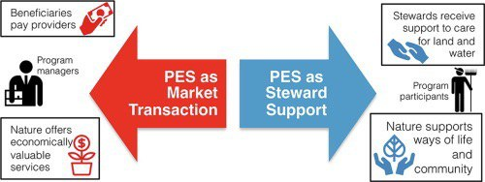
Fig.2: Costa Rica’s PES

Slide 10
CONCLUSION
Integrating conservation with development is essential for a sustainable future.
By balancing economic growth with environmental stewardship, we can achieve long-term prosperity and preserve the planet for future generations.

Slide 11
REFERENCES
https://www.researchgate.net/publication/5960649 CostaRica's Payment for Environmental Services Program Intention Implementation and Impact
Dalal-clayton et al, 1994 sustainable development strategies
https://www.fao.org/faolex/results/details/en/c/LEX-FAOC215484/
https://www.greenfacts.org/en/biodiversity/l-3/6-conserve-biodiversity.htm

Slide 12
GROUP MEMBERS
OWUSU EDWARD PEPRAH
HUKPORTIE VINCENT MENSAH
BUAH TYRA NANA SOWAH
GYAMFI KWAME FRIMPONG
BONSU DANIELLA ABENA
DJONOR AUDREY ANTHONIA
ADDO LAWRENCIA AHEMAA LARTEY
AFRIFAH BONSU RODDICK
SARKODIE EVANS
KUSI YEBOAH ANDY
GYIMAH THOMAS ABU NANA KWESI

Slide 13


